Slide 1
Dynamic Anomaly Detection on Apache Logs
Aneet Kumar Dutta
Devanshu Mishra
12/06/2019

Slide 2
Introduction
Dynamic Log based Intrusion Detection is developed using Apache server access log.
The anomaly detection method is applied on log files is based on completely unsupervised technique.
Why unsupervised learning is required?
In supervised techniques, the data of both normal and malicious class needs to available and proper labelling of the data needs to be done.
In semi-supervised approach where we try to model the normal behavior and any behavior that deviates from the normal behavior is detected to be anomaly. This gives a very static behavior of the system and does not always consider the change in behavior with time giving rise to false positives.

Slide 3
Steps for Anomaly Detection
Preprocess the data by extracting timestamp and removing the randomized tokens in the log line
Clustering of log lines based on Levenshtein distance.
Determining cluster transition from previous to current time window.
Extract cluster evolution metric(size) for each cluster in different time window and form a time series.
Fit ARIMA model on the time series and predict the value for next time step.
Anomaly is detected by calculating the difference between the actual value in the next time step and the previously predicted value.

Slide 4
Dataset
To implement the anomaly detection mechanism real time Apache log is captured from our own C3I center’s website https://security.cse.iitk.ac.in/
Each time window is considered to be of 200 log lines.
Here is a snapshot of how the logs look like:
Oct 22 04:21:21 lxc41_xxG_50G access 144.76.81.229 - - [22/Oct/2018:04:21:21 +0000] "GET /node/498 HTTP/1.1" 200 4213 "-" "Mozilla/5.0 (compatible; MJ12bot/v1.4.8;
The log lines are pre-processed by extracting the only the URL request.
The log lines used in the anomaly detection mechanism is “GET /node/498”

Slide 5
Clustering
Each log line is considered a string and the clustering is done based on the Levenshtein distance between the current log line and the candidate log lines(representative of each cluster).
If the threshold Levenshtein distance is decreased the number of clusters in each time window increases.
Example of clusters formed in a time window.
[set(['GET /node/194 ', 'GET /node/481 ', 'GET /node/449 ', 'GET /node/376 ', 'GET / HTTP/1.0', 'GET /node/361 ', 'GET /news?page=0&qt-news=1 ', 'GET /node/464 ', 'GET /node/138 ']),
set(['GET /sites/default/files/js/js', 'GET /sites/default/files/15111024.pdf ', 'GET /sites/default/files/background.gif ', 'GET /sites/default/files/css/css']),
set(['GET /sites/default/files/styles/thumbnail/public/']),
set(['GET/sites/default/files/inline-images/cyber%20cell-W.png ']),
set(['GET /sites/default/files/styles/large/public/2018-04/30742211', 'GET /sites/default/files/styles/large/public/2018-04/28947900', ]); where each set denotes a cluster

Slide 6
Cluster Transition
In cluster transition, the previous time step cluster is mapped to the current time step cluster to understand the cluster evolution.
The previous cluster lines are mapped into the current time step clusters by using the previous time windows log lines and the current time windows candidate lines.
Here is an example:
{0: [0], 2: [1], 3: [2, 3], 4: [2, 3], 5: [4], 6: [5], 10: [6], [7,9]:11}
The cluster number 0 at previous time step is mapped to cluster number 0 of the current time step, cluster number 2 is mapped to cluster number 1, 3 is mapped to 2 and 3 and so on.
Cluster 3 at previous time step is splitted in the next time step and cluster number 7 and 9 is absorbed into cluster number 11.
The cluster transition are then used to form the time series for anomaly detection by considering cluster size of each of the clusters at different time stamps.

Slide 7
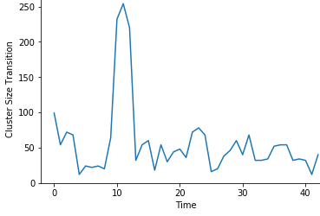
Time Series
This above graph shows the cluster size transition of a cluster at different time steps.
This time series data is fit into ARIMA model to detect anomalies.

Slide 8
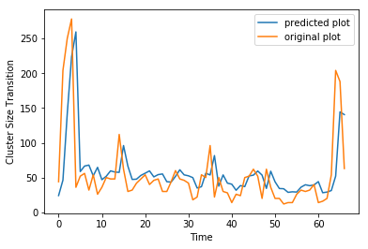
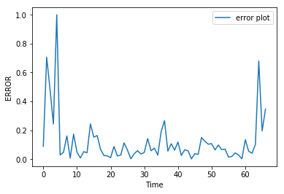
Anomaly Detection using ARIMA model
The time series data is fit into the ARIMA model and the value at next time step is predicted.
The log line is malicious or normal is based on the threshold set on the error which is the difference between the predicted value and the actual value.

Slide 9
The error is normalized and ranges between 0 to 1.
The value close to 1 depicts anomaly.
The threshold is set at 0.6 to declare a window as malicious.

Slide 10
Conclusion
The anomaly detection mechanism is completely unsupervised which considers the dynamic behavior of the system.
Each log line is considered as string and clustered using Levenshtein distance, so no parser is required to parse the log lines.
The cluster is mapped to previous and next window to understand the cluster transition.
Cluster size is considered as cluster evolution metric which is used for anomaly detection.
The value of error above 0.6 is considered to be malicious.

